Slide 1
RRT Program
Began in 2008 with 6 pilot states focused on building multi-disciplinary rapid response teams (RRTs) with capacity to respond to any type of food/feed emergency
Currently 24 states participate (18 funded, 6 voluntary), involving 11 FDA HAF Divisions
RRTs can apply for up to $300k per year for development
Program is so successful that several states are developing or maintaining voluntary RRTs with no federal funding
Most successful program accomplishments
Development of RRT Capacity Building & Mentorship Process (seeking approval to distribute through PFP)
RRT Best Practice Manual (15 chapters, >700 pages)
Capability Assessment Tool (program metrics)

Slide 2
Who is on the RRT?
5 ‘legs’ of the RRT
Food Program
Feed Program
FDA Division/ District
Laboratory
Epidemiology

Slide 3
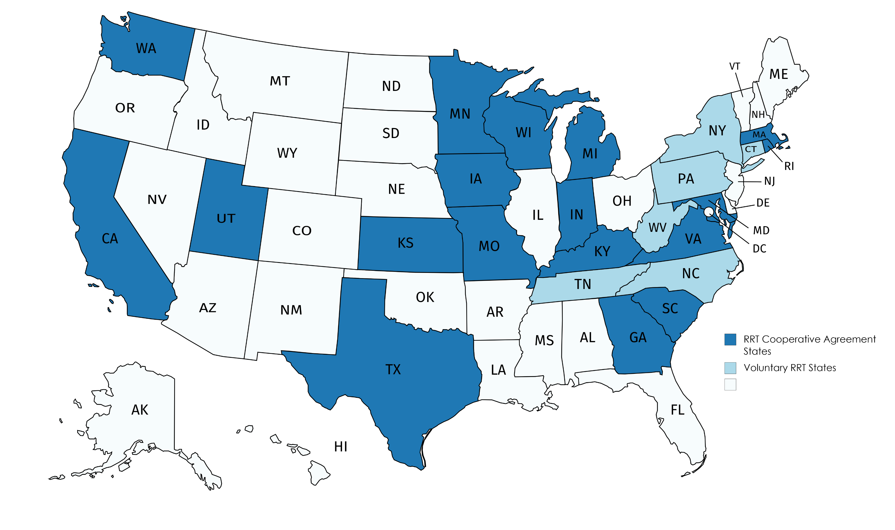
Updated: October, 2019
Rapid Response Teams: 2019 – 2020 Grant Year

Slide 4
RRT Bottom Line (The Hook)
Ultimate Goal: Improve the effectiveness of multi-jurisdictional food/feed emergency responses with the ultimate objective of reducing the time from agency notification to implementation of effective control measures
How: Use ICS; Enhanced capacity; Advanced training; Operate as one unified team to protect public health while meeting agency requirements/mission
Bonus Outcome: Capture best practices and share them with others!!

Slide 5
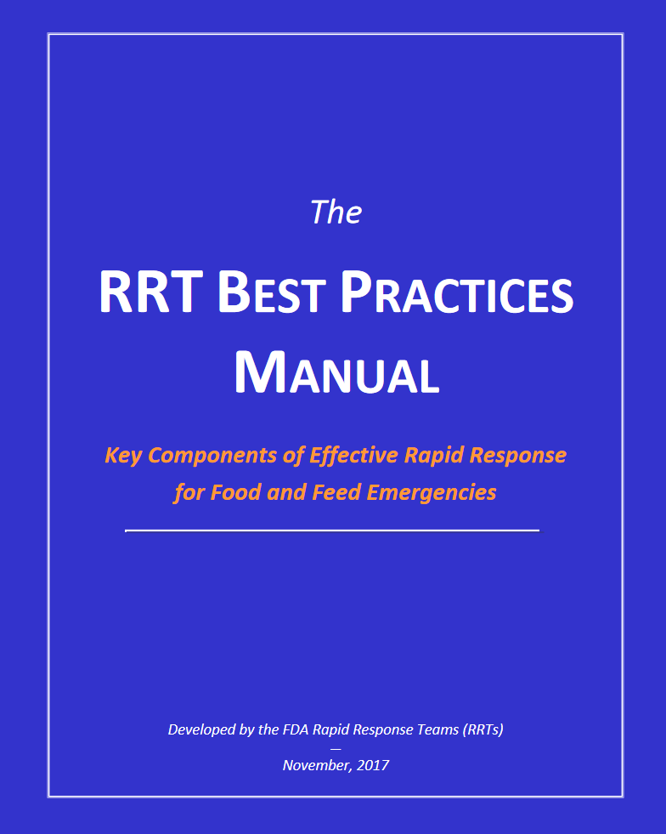
The RRT Best Practices Manual (2017 Edition)
Available online: https://www.fda.gov/media/123908/download
15 Chapters
Emphasizes multi-jurisdictional collaboration and teambuilding
Many examples, templates & resources

Slide 6
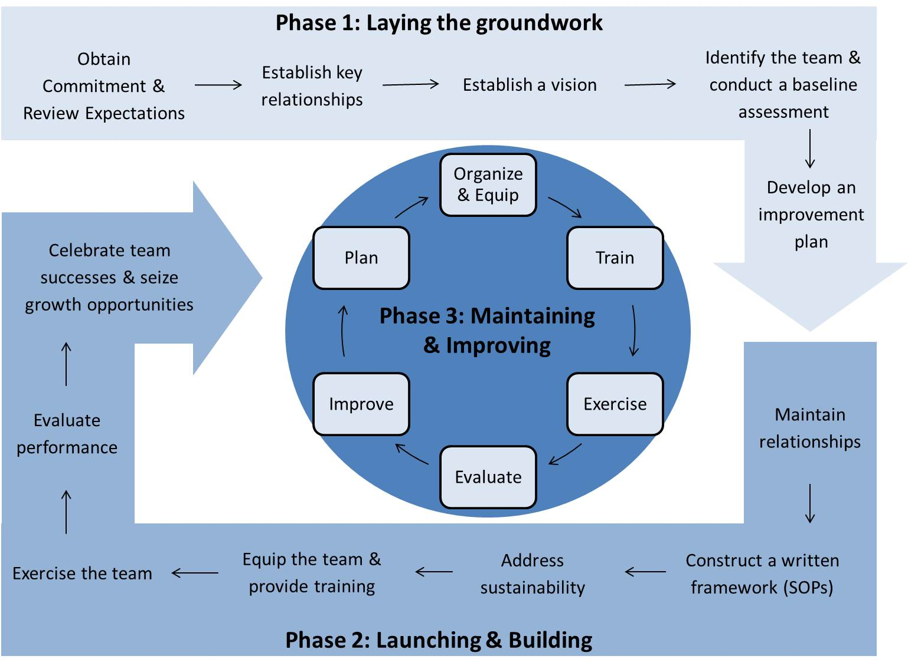
A Roadmap for RRT Development
Using lessons learned and feedback from the 9 Original RRTs, the RRT Capacity Building Process was developed. This document outlines steps for establishing a team and implementing the best practices within the RRT Manual: individual steps cross-reference specific Chapters within the Manual.

Slide 8
A look at the 2017 RRT CAT Data
444 incidents investigated
416 responses (94%)
28 activations (6%)
Human illness or outbreak linked (53%)
Positive sample investigation (11%)
Recall effectiveness checks & traceforward (21%)
Other (15%)
20 RRTs reporting data from the Sep2016-Aug2017 grant year
Notes:
Lauren

